Slide 1
America has opened its doors to 60,000 Afghans fleeing Taliban rule
Will you open your heart to them?

Slide 2
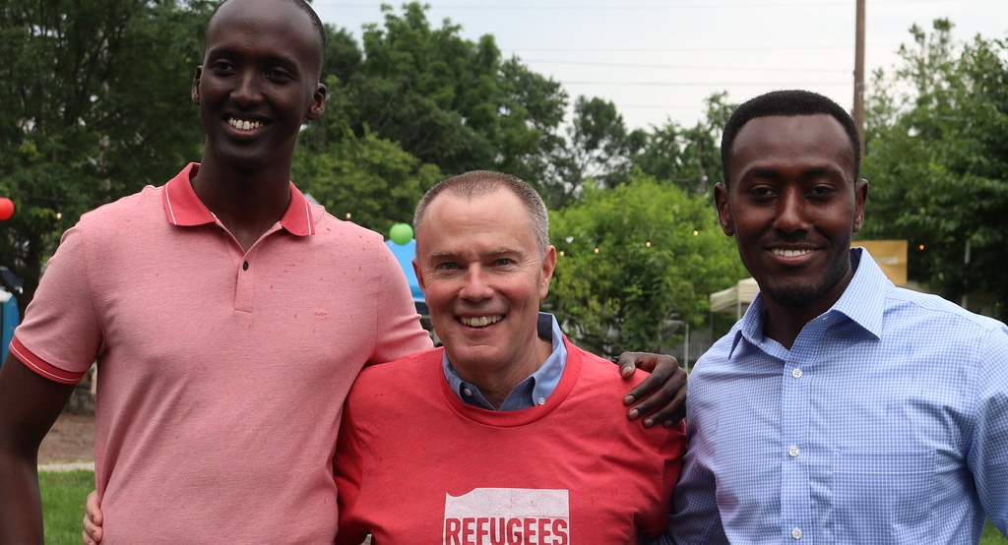
“The stranger who dwells among you shall be to you as one born among you, and you shall love him as yourself” Leviticus 19:34

Slide 3
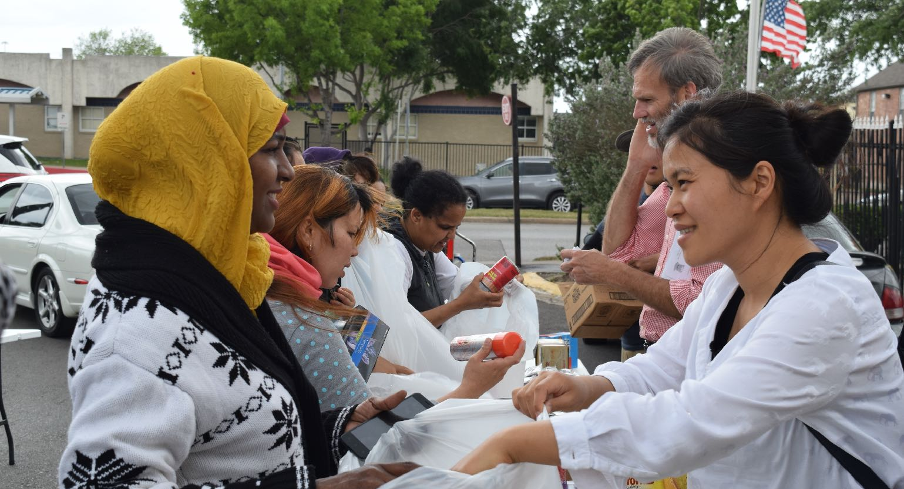
We should be able to see in the multiplying opportunities to reach many foreigners in America a divinely appointed means of rapidly extending the third angel’s message into all the nations of earth (Evangelism 570).

Slide 4
Join a Welcome Team for refugees who have just arrived

Slide 5
Buy necessary supplies for refugees

Slide 6
Tutor English or U.S. Civics

Slide 7
Help start club ministries or after- school care programs at their apartments

Slide 8
Mentor a refugee youth

Slide 9
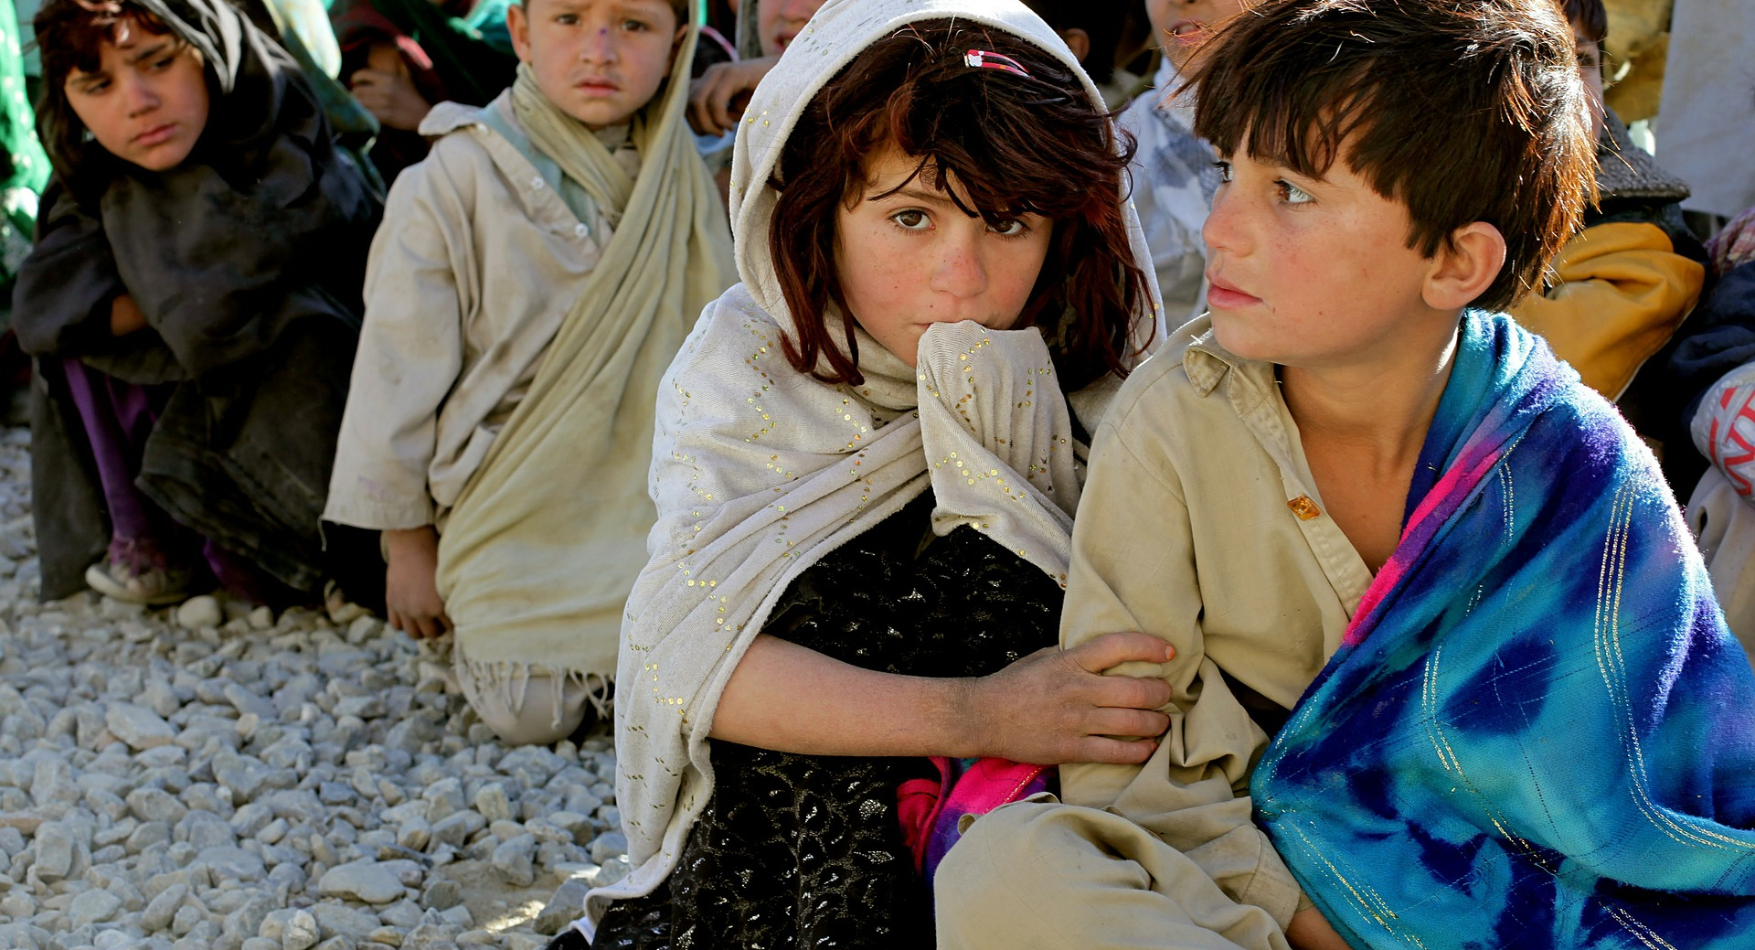
Get involved now at:
reachtheworldnextdoor.com/ training/Houston

