Slide 1

Reachtheworldnextdoor.com

Slide 2

“Go home to your friends, and tell them what great things the Lord has done for you, and how He has had compassion on you”
Mark 5:19

Slide 3

“Our confession of His faithfulness is Heaven’s chosen agency for revealing Christ to the world. We are to acknowledge His grace as made known through the holy men of old; but that which will be most effectual is the testimony of our own experience. We are witnesses for God as we reveal in ourselves the working of a power that is divine.
The Desire of Ages 347

Slide 4
Every individual has a life distinct from all others, and an experience differing essentially from theirs. God desires that our praise shall ascend to Him, marked by our own individuality. These precious acknowledgments to the praise of the glory of His grace, when supported by a Christ-like life, have an irresistible power that works for the salvation of souls.
The Desire of Ages 347

Slide 5

What has God done for you?
How has He changed you?
What miracles have you experienced
that help you know God is real and truly cares?

Slide 6

Who do you know that needs to hear
the stories you just shared?

Slide 7

Pray together for the individuals you want to share with and for God to open their hearts. Watch and pray. Step out in faith.

Slide 8
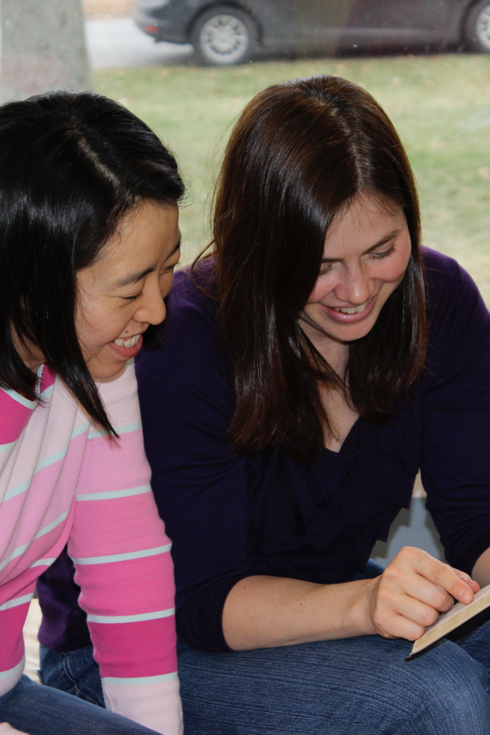
“The secret of our success and power will be found in making direct, personal appeals to those who are interested, having unwavering reliance upon the Most High.”
Pamphlet 118 2

Slide 9

What positive activities might your unchurched friends enjoy doing with you?

Slide 10
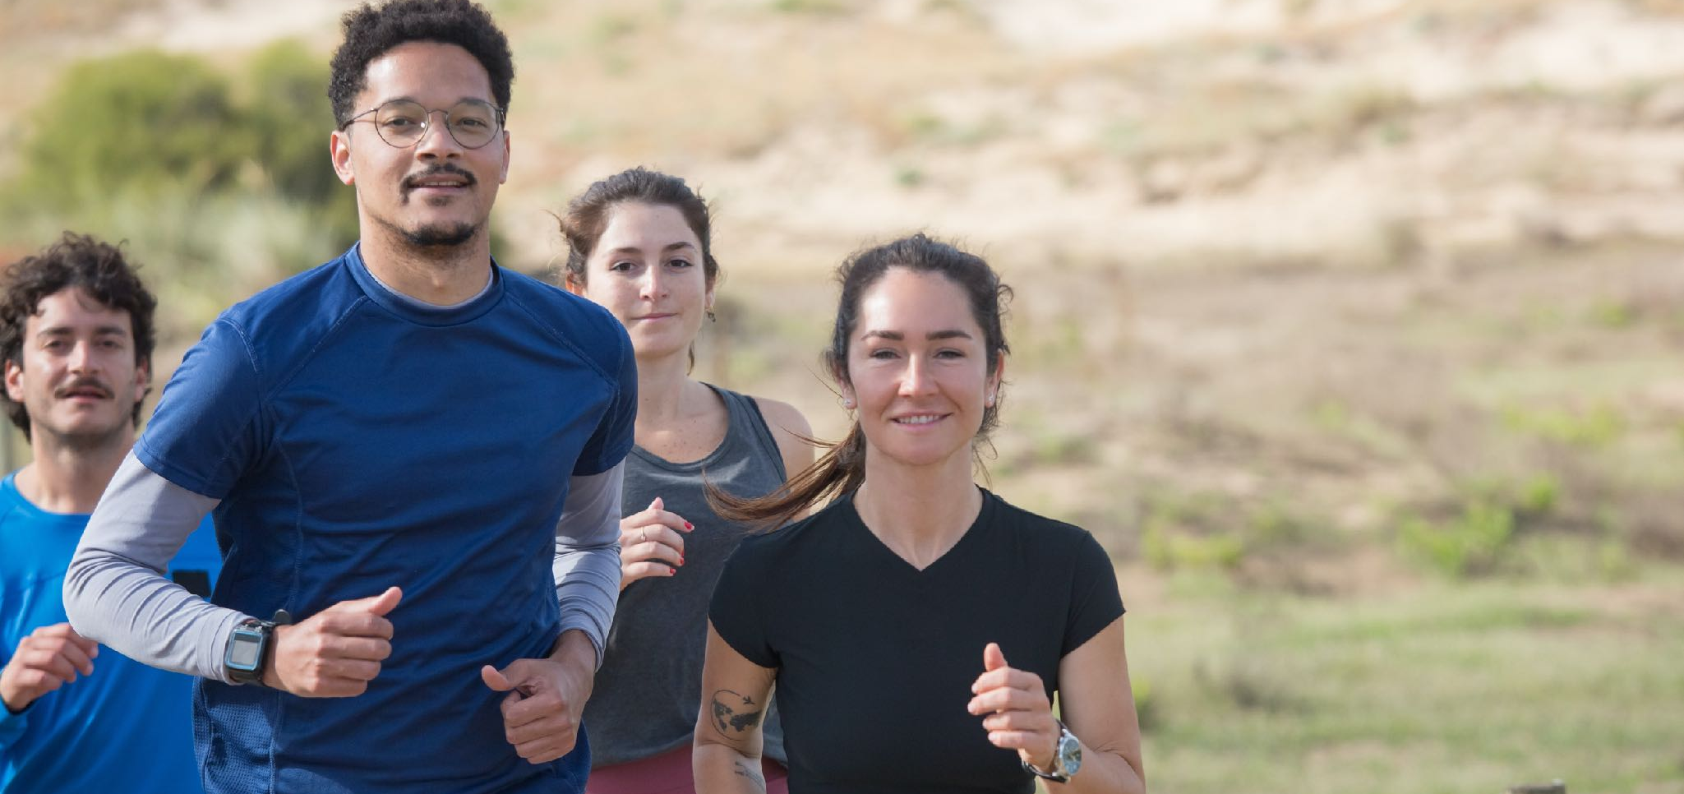
Think about your friends who needs Jesus. List three things you will invite them to do. Number them 1, 2, 3 starting
with the first thing you will do together.

Slide 11
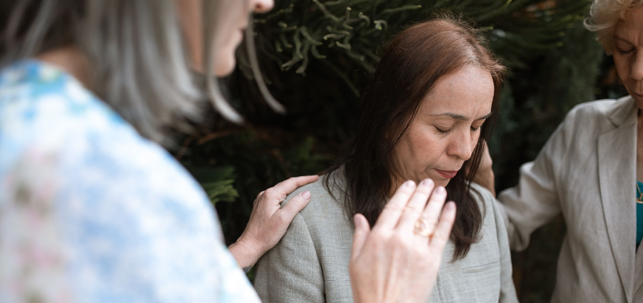
Pray again for these friends
that the Holy Spirit will give them
a genuine encounter with God.

Slide 12
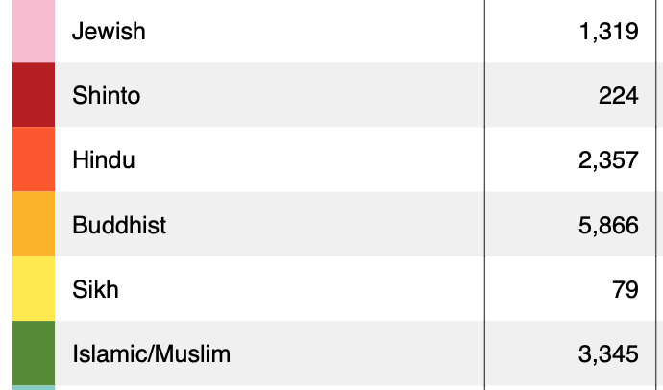
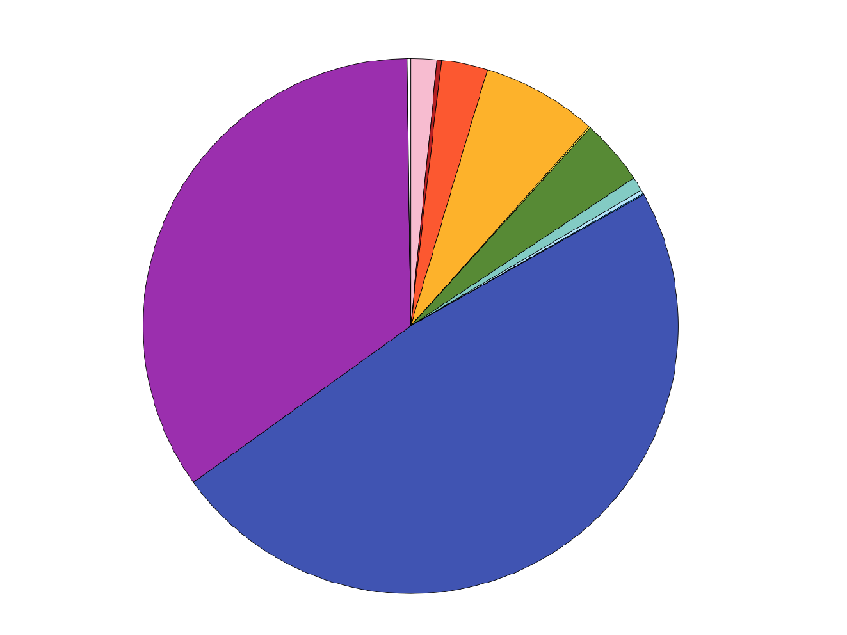
Katy’s
Mission
Field

Slide 13
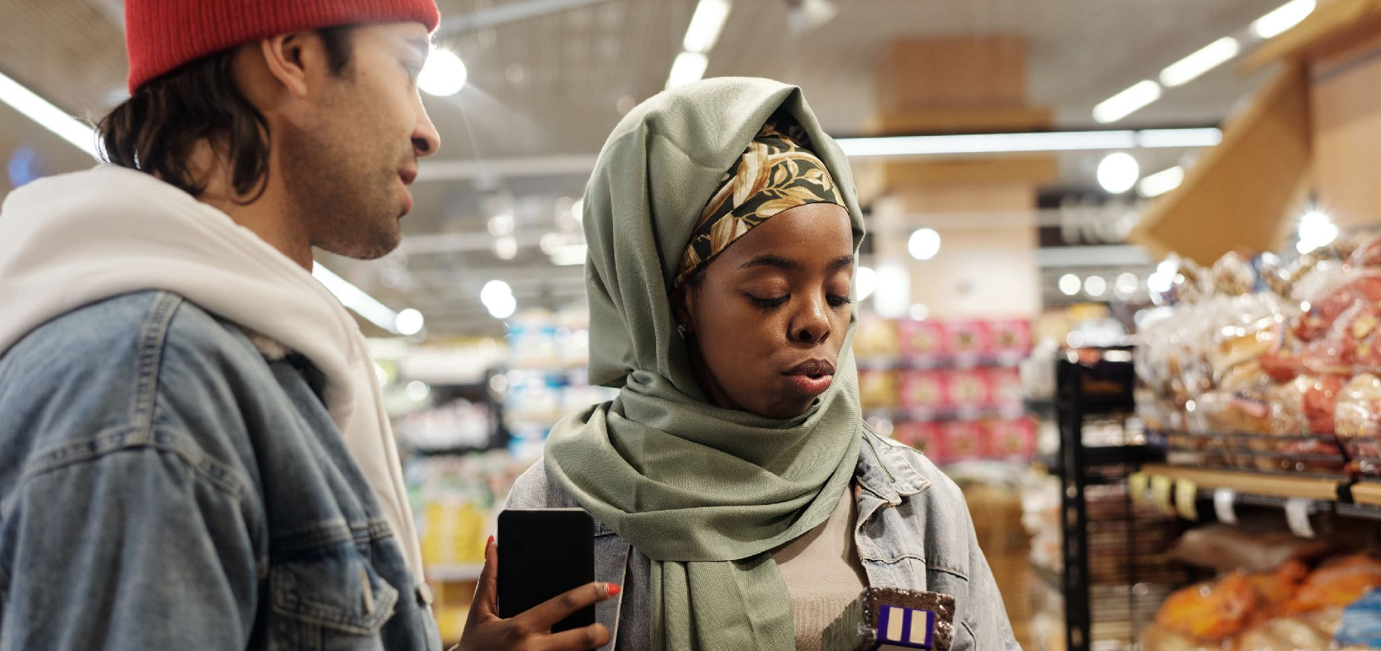
Where do you cross paths with people
who do not go to your church?

Slide 14
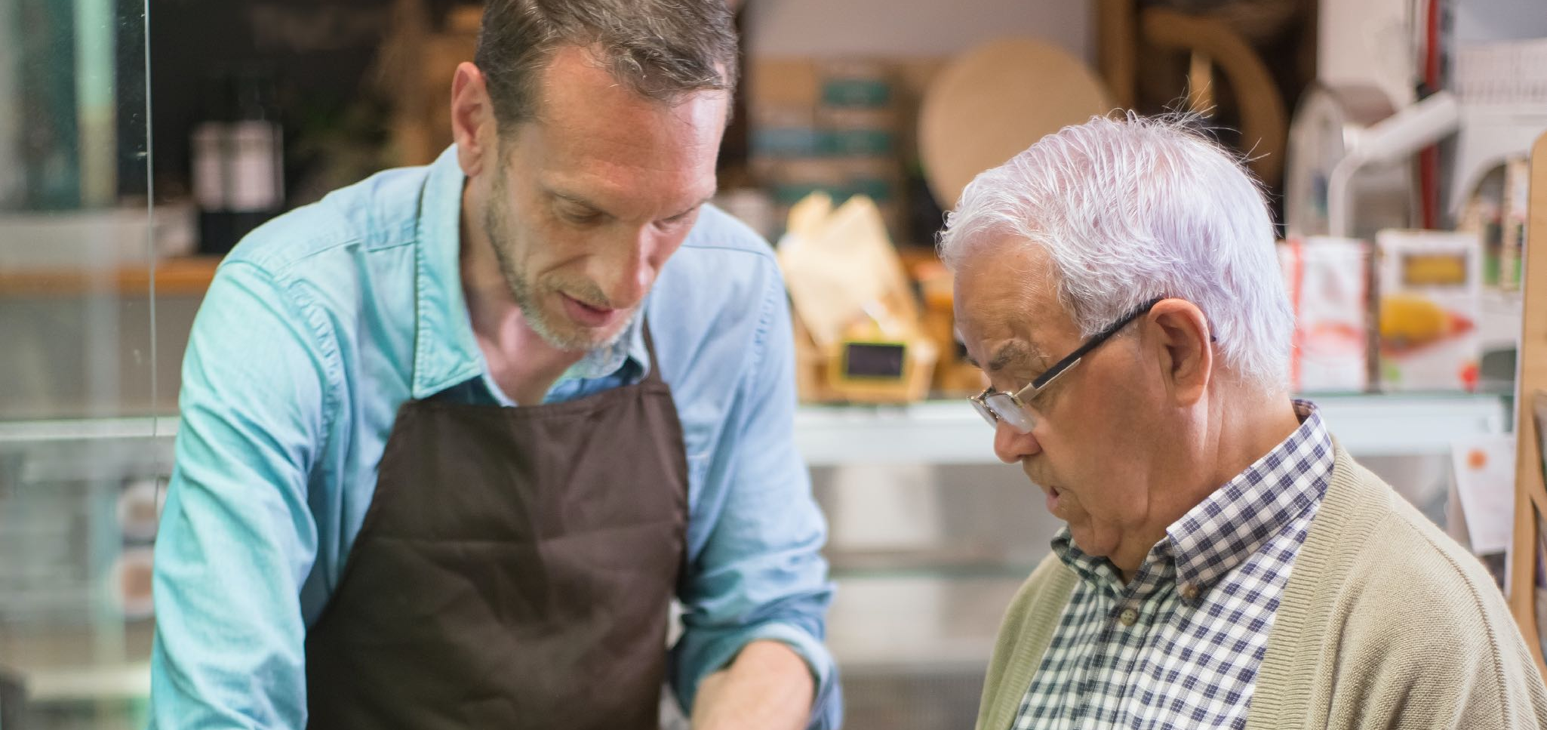
What could you say
to start a friendly conversation?

Slide 15

Pray together for divine appointments. Watch and pray.
Step out in faith.

Slide 16

“More than one thousand will soon be converted in one day, most of whom will trace their first convictions to the reading of our publications”
Evangelism 693.
“In a large degree through our publishing houses is to be accomplished the work of that other angel who comes down from heaven with great power and who lightens the earth with his glory [Rev. 18:1]”
Testimonies, Vol. 7, 140.

Slide 17


Slide 18
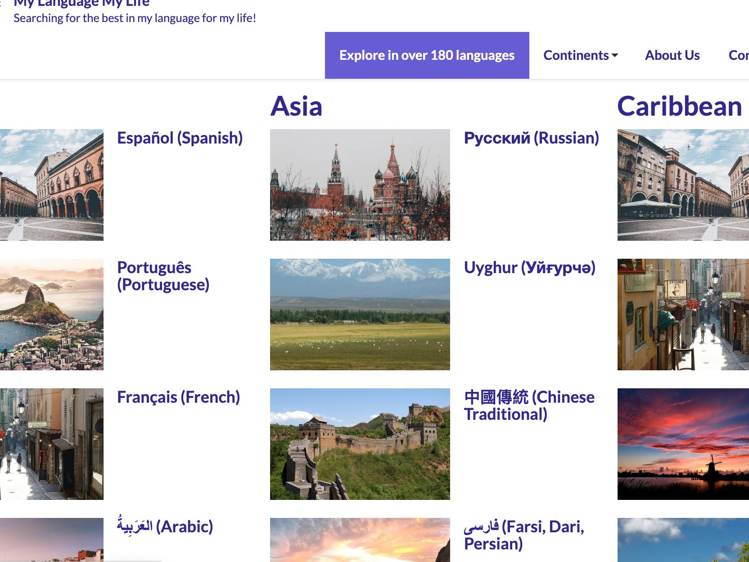

Slide 19
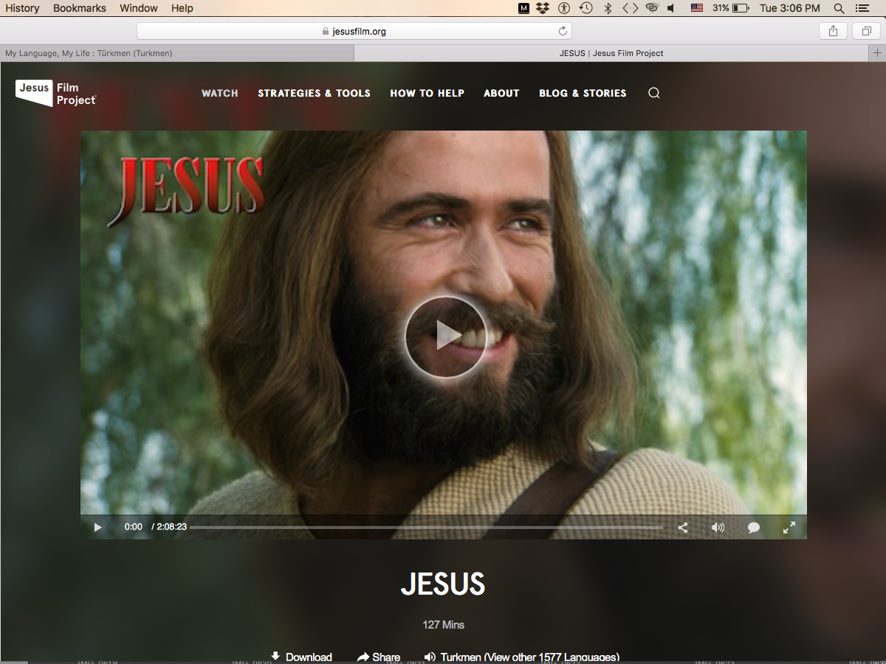

Slide 20
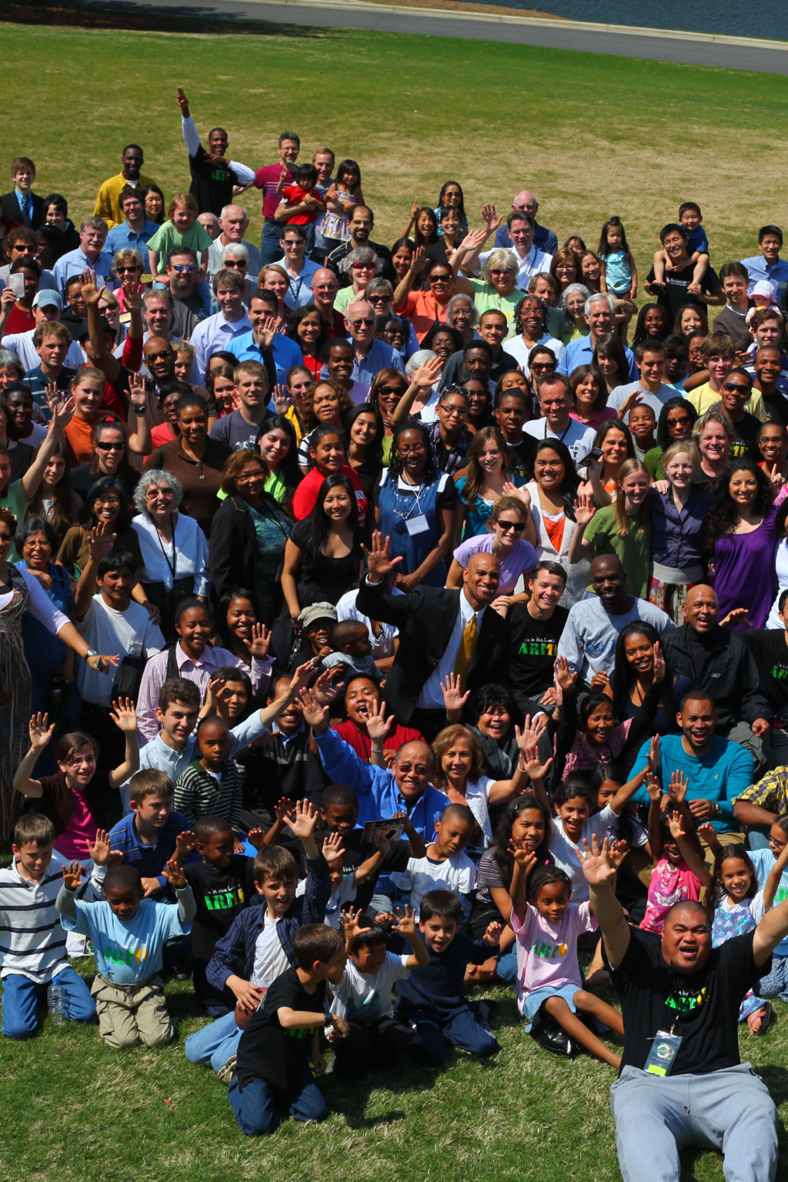
“During the loud cry, the church, aided by providential interpositions of her exalted Lord, will diffuse the knowledge of salvation so abundantly that light will be communicated to every city and town.
The earth will be filled with the knowledge of salvation.
So abundantly will the renewing Spirit of God have crowned with success the intensely active agencies, that the light of present truth will be seen flashing everywhere”
(Evangelism 694).

Slide 21
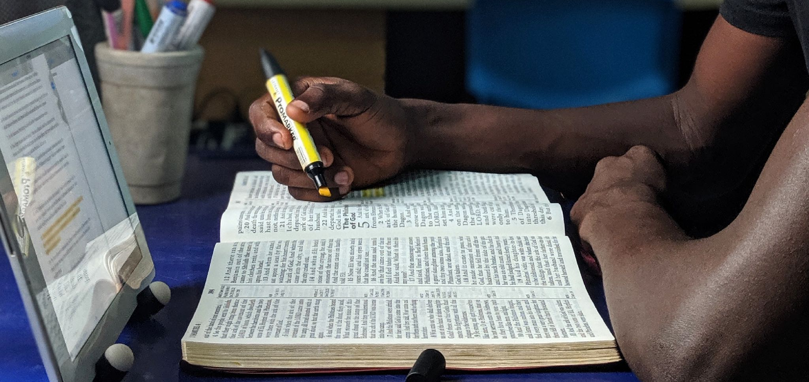
The answer for reaching the world is the Holy Spirit
What that looks like is spelled out in the Book of Acts and wherever it speaks of the Holy Spirit. Let’s study and pray for each specific part!

Slide 22
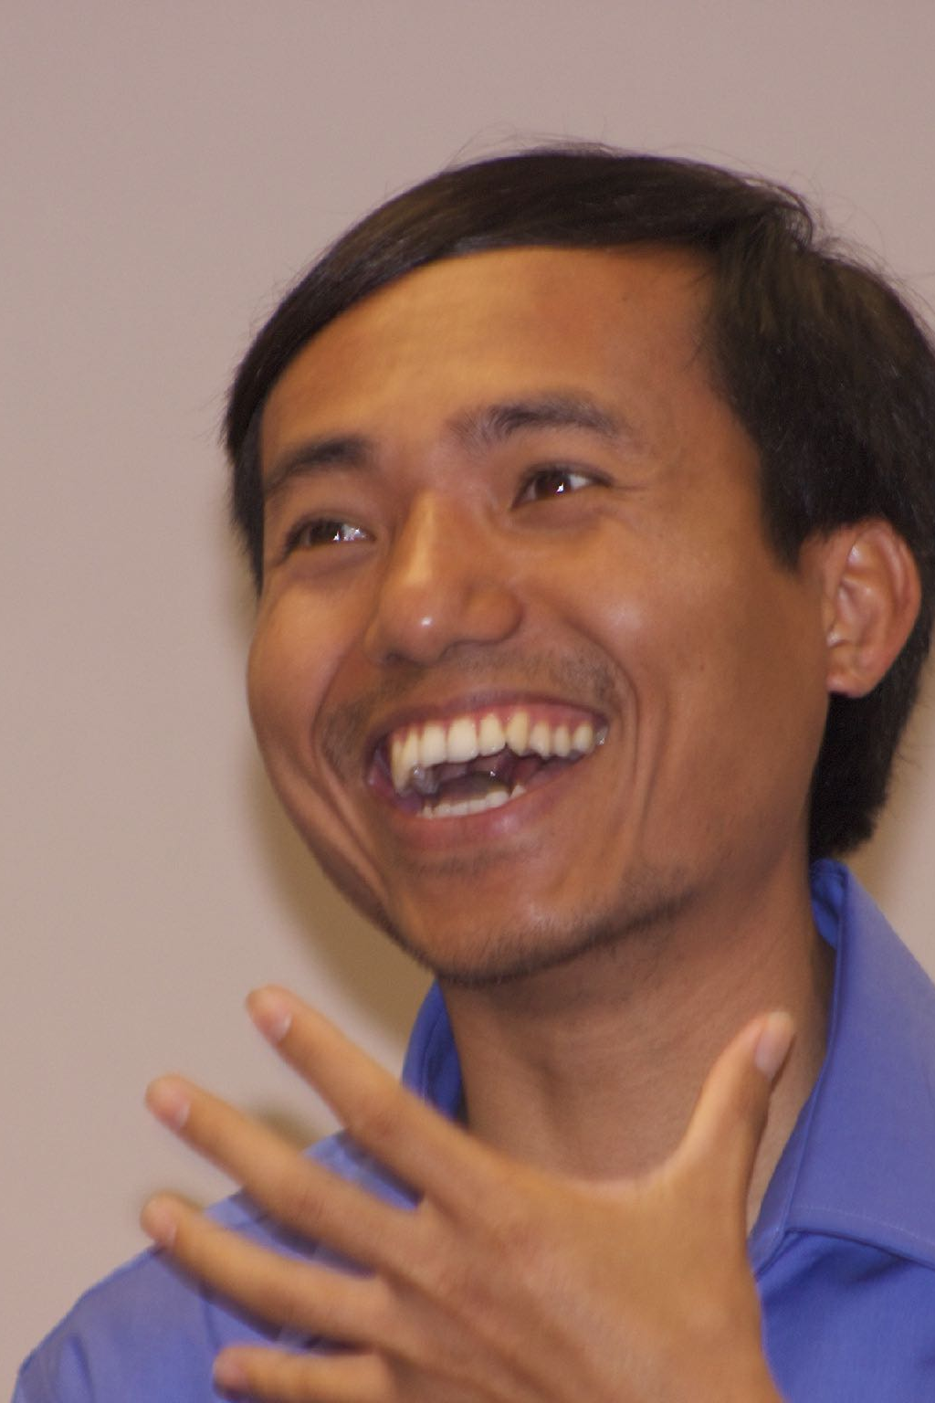
“The last message of mercy to be given to the world
is a revelation of His character of love.
The children of God are to manifest His glory.
In their own life and character they are to reveal
what the grace of God has done for them”
Christ’s Object Lessons, 415, 416.

Slide 23
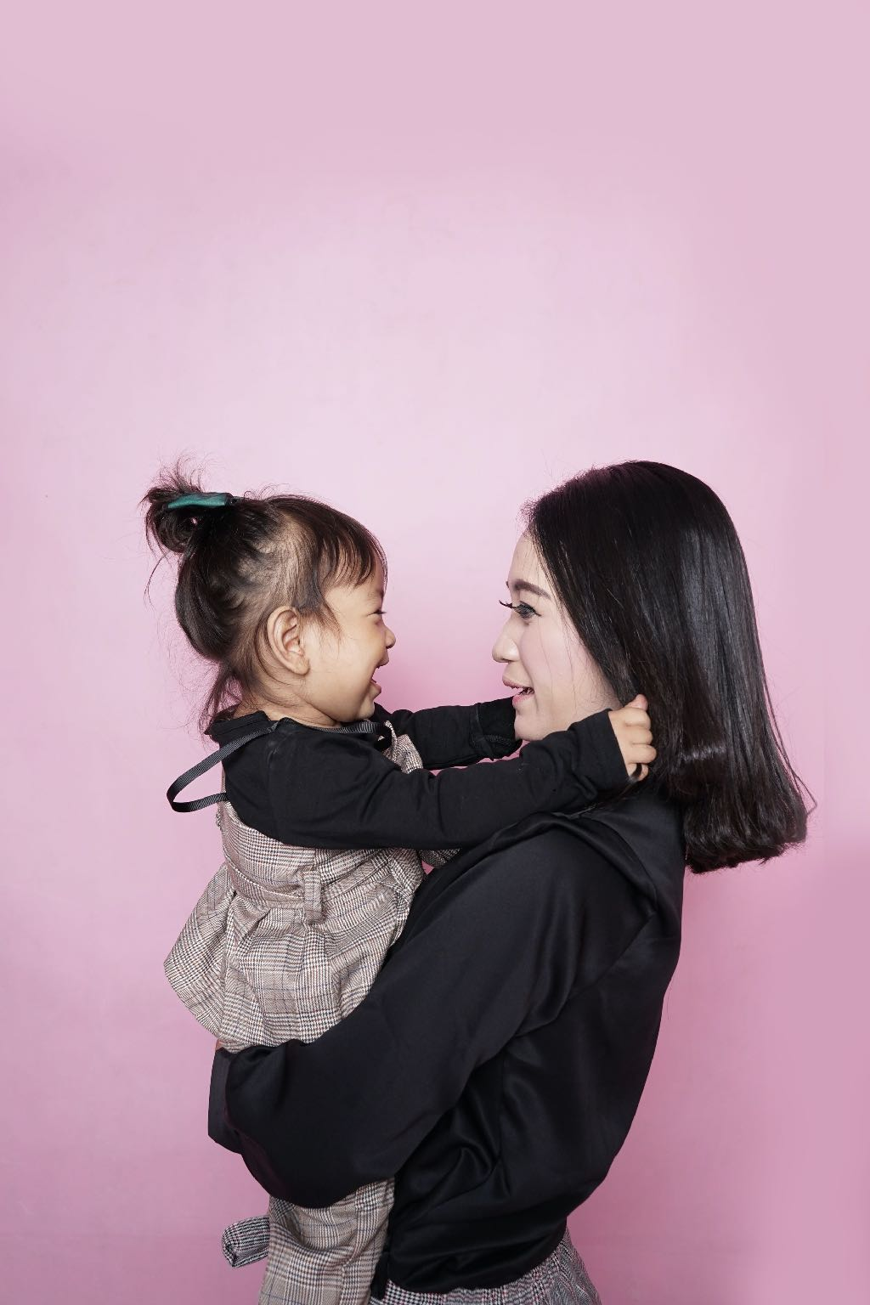
“There are many who have given themselves to Christ, yet who see no opportunity of doing a large work or making great sacrifices in His service. These may find comfort in the thought that it is not necessarily the martyr's self-surrender which is most acceptable to God; it may not be the missionary who has daily faced danger and death, that stands highest in heaven's records. The Christian who is such in his private life, in the daily surrender of self, in sincerity of purpose and purity of thought, in meekness under provocation, in faith and piety, in fidelity in that which is least, the one who in the home life represents the character of Christ, --such a one may in the sight of God be more precious than even the world-renowned missionary or martyr” Christian Service 102

Slide 24
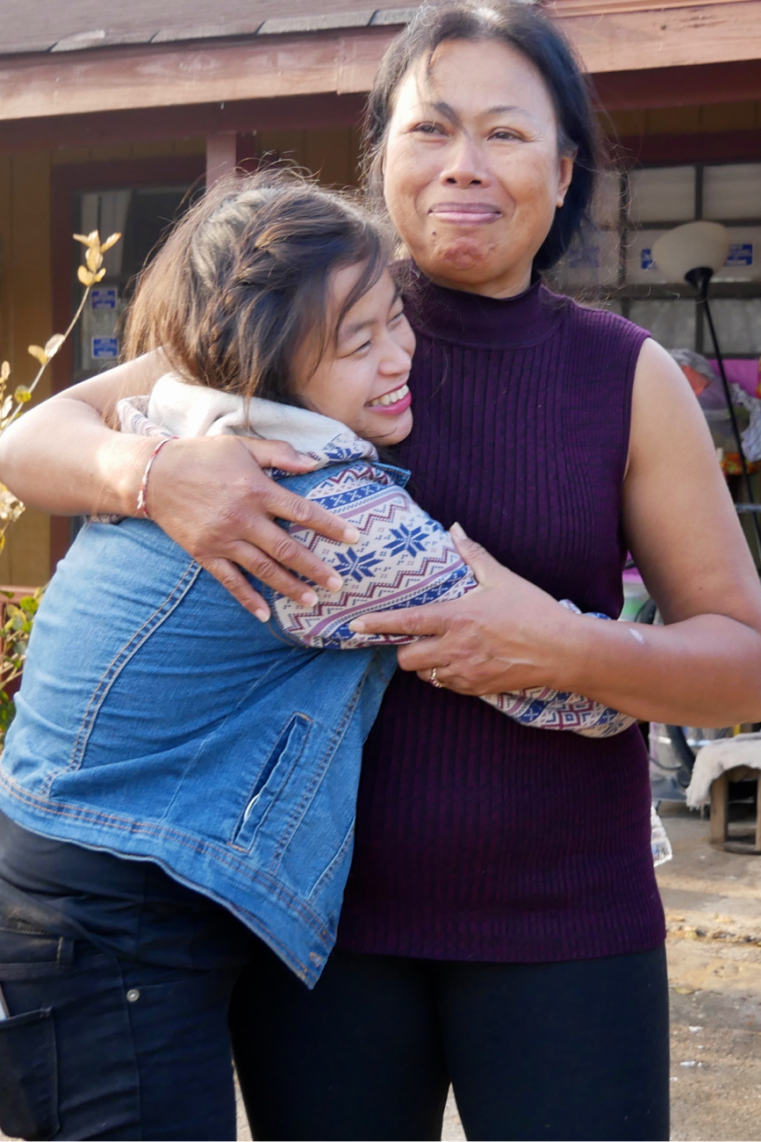
“After the descent of the Holy Spirit, the disciples were so filled with love for Him and for those for whom He died, that hearts were melted by the words they spoke and the prayers they offered.
They spoke in the power of the Spirit; and under the influence of that power, thousands were converted”
(Acts of the Apostles 22)

Slide 25

Which of the fruits of the Spirit
do you feel you need the most?
How can you have more of the fruit of the Spirit?

Slide 26
“The great work of the gospel is not to close with less manifestation of the power of God than marked its opening. The prophecies which were fulfilled in the outpouring of the former rain at the opening of the gospel, are again to be fulfilled in the latter rain at its close. . . .
Servants of God, with their faces lighted up and shining with holy consecration, will hasten from place to place to proclaim the message from heaven. By thousands of voices, all over the earth, the warning will be given.
Miracles will be wrought, the sick will be healed, and signs and wonders will follow the believers”
Great Controversy, 611, 612.

Slide 27

Which of the gifts of the Spirit do you wish was
more lived out through your church?
What can you do to help your church
be full of the Holy Spirit?

Slide 28
The Lord can do more in one hour than we can do in a whole lifetime, and when He sees that His people are fully consecrated, a great work will be done in a short time and the message of the truth will be carried into the dark places of the earth, where it has never been proclaimed.
Manuscript Release
Volume 5, 347

Slide 29
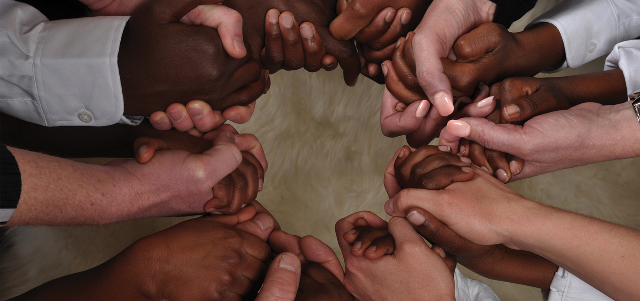
Pray for each other and for our churches to have more of these wonderful character qualities
that will attract new people.

Slide 30
Reachtheworldnextdoor.com

